Slide 1

analysis, Brazilian E-commerce store for the time period 2016-2018
There are 9 datasets to play with and explore. The data model has been described in image below and it is organised and Normalised for each category.

Slide 2
Sales for states over year in Brazilian E-commerce store

Slide 3
Count Payment Type in Brazilian E-commerce store

Slide 4
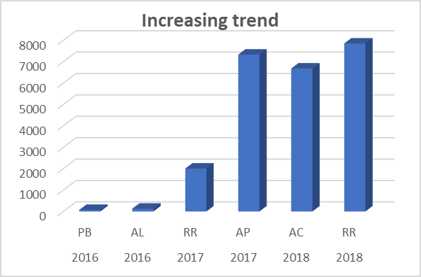
Top 2 States Increasing trend over the years in Brazilian E-commerce store

Slide 5
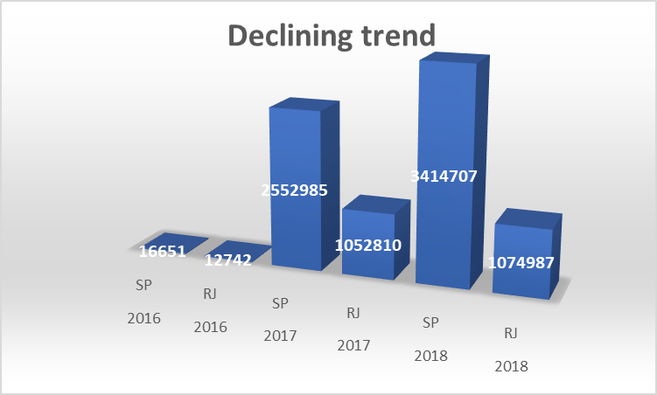
Top 2 States Declining trend over the years in Brazilian E-commerce store

Slide 6
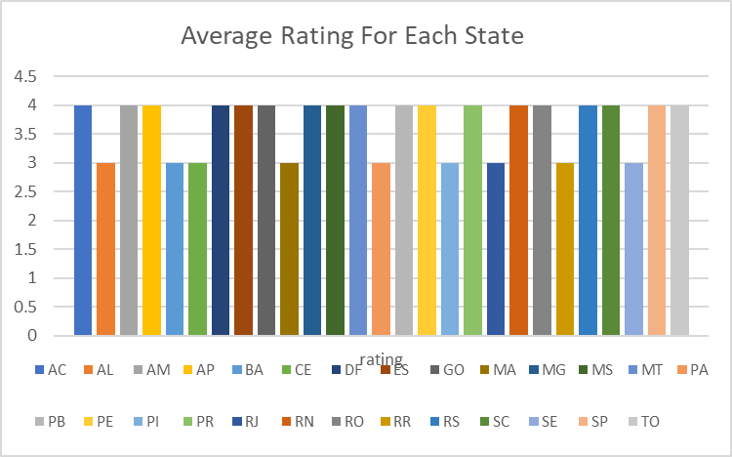
Average Rating For Each State in Brazilian E-commerce store

Slide 7
CATEGORY-WISE Total Revenue in Brazilian E-commerce store

Slide 8
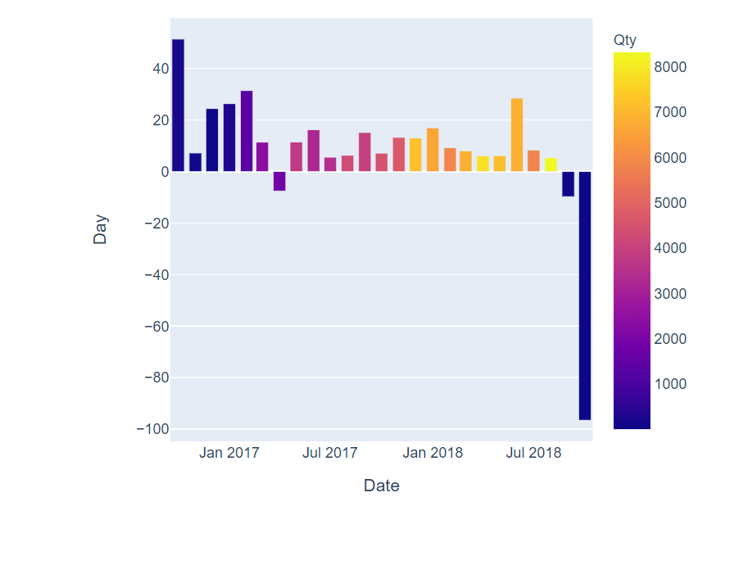
Delivery Interval (Estimated vs Actual) per Month data in Brazilian E-commerce store

